Slide 1
INTRODUTION TO HTML

Slide 2
Definitions
W W W – World Wide Web.
HTML – HyperText Markup Language – The Language of Web Pages on the World Wide Web.
HTML is a text formatting language.
URL – Uniform Resource Locator.
Browser – A software program which is used to show web pages.

Slide 3
INTRODUCTION OF HTML
HTML is a language for describing web pages.
HTML is not a programming language, it is a markup language
A markup language is a set of markup tags
HTML uses markup tags to describe web pages

Slide 4
INTRODUCTION OF HTML
It is simply a collection of certain key words called ‘Tags’ that are helpful in writing the document to be displayed using a browser on Internet.
It is a platform independent language that can be used on any platform such as Windows, Linux, Macintosh, and so on.
To display a document in web it is essential to mark-up the different elements ( headings , paragraphs , tables , and soon ) of the document with the HTML tags.

Slide 5
INTRODUCTION OF HTML
To view a mark-up document user has to open the document in a browser.
A browser understands and interpret the HTML tags, identifies the structure of the document (which part are which) and makes decision about presentation (how the parts look) of the document.
HTML also provides tags to make the document look attractive using graphics, font size and colors.
User can make a link to the other document or the different section of the same document by creating Hypertext Links also known as Hyperlinks

Slide 6
OBJECTIVE OF HTML
To create, save and view a HTML document
To format a web page using section heading tags
To describe Ordered and Unordered lists
To explain graphics in HTML document describe hypertext links and making text/image link

Slide 7
WORLD WIDE WEB
The World Wide Web (abbreviated as WWW or W3 and commonly known as the Web) is a system of interlinked hypertext documents accessed via the Internet.
With a web browser, one can view web pages that may contain text, images, videos, and other multimedia and navigate between them via hyperlinks.

Slide 8
HTML TOOLS
There are two tools of HTML.
HTML Editor: it is the program that one uses to create and save HTML documents. They fall into two categories:
- Text based or code based which allows one to see the HTML code as one is creating a document.e.g. Notepad.
Pages end with “.htm” or “.html”
- Netscape composer

Slide 9
HTML TOOLS
b) Web Browser:
it is the program that one uses to view and test the HTML documents.
They translate Html encoded files into text,image,sounds and other features user see.
Microsoft Internet Explorer, Netscape, Mosaic Chrome are examples of browsers that enables user to view text and images and many more other World Wide Web features.
They are software that must be installed on user computer.

Slide 10
Naming conventions for HTML files
Use proper suffixes for your files.
  HTML and XHTML files must end with .html. Web graphics must be labeled according to their file format: .gif, .png, or .jpg (.jpeg is also acceptable).
Never use character spaces within filenames.
  It is common to use an underline character or hyphen to visually separate
words within filenames, such as robbins_bio.html or robbins-bio .html.
Avoid special characters
  such as ?,%, #, /, :, ;, •, etc. Limit filenames to letters, numbers, underscores,
hyphens, and periods.
Filenames may be case-sensitive.
  depending on your server configuration. Consistently using all lowercase letters in filenames, although not necessary, is one way to make your filenames easier to manage.
Keep filenames short.
Short names keep the character count and file size of your HTML file in check.
  If you really must give the file a long, multiword name, you can separate words with hyphens, such as a-long-document-title. html, to improve readability.
Self-imposed conventions
. It is helpful to develop a consistent naming scheme for huge sites. For instance, always using lowercase with hyphens between words.

Slide 11
HTML TERMINOLOGY
Some commonly used terms in HTML are:
a)Tag: Tags are always written within angles brackets.
  it is a piece of text is used to identify an element so that the browser realizes how to display its contents.
  e.g.<HTML> tag indicates the start of an HTML document .HTML tag can be two types.
  They are:-
    Paired Tags
    Unpaired Tags

Slide 12
Paired Tags :
  A tag is said to be a paired tag if text is placed between a tag and its companions tag.
  In paired tag ,the first tag is referred to as opening tag and the second tag is referred to as closing tag.
Unpaired Tags:
  An unpaired tag does not have a companion tag . unpaired tag also known as singular or Stand-alone tags.
  e.g:<br>,<hr> etc.

Slide 13
HTML TERMINOLOGY
b) Attribute:
Attribute is the property of an tag that specified in the opening angle brackets.
It supplies additional information like colour, size, home font-style etc. to the browser about a tag.
E.g. most of the common attributes are height, colour, width, src, border, align etc.

Slide 14
c) DTD:
Document Type Definition is a collection of rules written in standard Generalized Markup Language (SGML).
HTML is defined in terms of its DTDS.
All the details of HTML tags, entities and related document structure are defined in the DTDS.

Slide 15
d) ELEMENT:
Element is the component of a document’s structure such as a title, a paragraph or a list.
It can include an opening and a closing tag and the contents within it.

Slide 16
Exercise 1
Black Goose Bistro
The Restaurant
The Black Goose Bistro offers casual lunch and dinner fare in hip atmosphere. The menu changes regularly to highlight the freshest ingredients.
Catering
You have fun... we’ll handle the cooking. Black Goose Catering can handle events from snacks for bridge club to elegant corporate fundraisers.
Location and Hours
Seekonk, Massachusetts;
Monday through Thursday 11am to 9pm, Friday and Saturday, 11am to
midnight

Slide 17
Document type declaration
<!DOCTYPE html>
  As the first line
Latest Version of HTML

Slide 18
HOW TO CREATE AN HTML DOCUMENT
The essential tags that are required to create a HTML document are:
<HTML>.............</HTML>
<HEAD>.............</HEAD>
<BODY>.............</BODY>

Slide 19
HTML Tag <HTML>
The <HTML> tag encloses all other HTML tags and associated text within your document.
You can create an HTML document that omits these tags, and your browser can still read it and display it.
But it is always a good form to include the start and stop tags.
The format is: <HTML>

Slide 20
HTML Tag <HTML>
Your Title and Document (contains text with HTML tags) goes here </HTML>
Most HTML tags have two parts, an opening tag and closing tag.
The closing tag is the same as the opening tag, except for the slash mark e.g. </HTML> used in closing tags.

Slide 21
An HTML document has two distinct parts HEAD and BODY
<HTML>
<HEAD>
.............
.............
.............
</HEAD>
<BODY>
.............
.............
.............
</BODY>
</HTML>

Slide 22
HEAD Tag <HEAD>
HEAD tag comes after the HTML start tag.
It contains TITLE tag to give the document a title that displays on the browsers title bar at the top. The Format is:
<HEAD>
<TITLE>
Your title goes here
</TITLE>
</HEAD>

Slide 23
HEAD Tag <HEAD>(continued..)
meta elements
  Within the head element provide information about the document itself.
  Specifies the character encoding (the standardized collection of letters, numbers, and symbols) used in the document.
<meta http-equiv="contenttype"
content="text/html;
charset=UTF-8">
Indicated before <TITLE>

Slide 24
BODY Tag <BODY>
The BODY tag contains all the text and graphics of the document with all the HTML tags that are used for control and formatting of the page.
The Format is:
  <BODY>
  Your Document goes here
  </BODY>

Slide 25
Attributes used with <BODY>
BGCOLOR: used to set the background color for the document Example:
<BODY BGCOLOR="yellow">
Your document text goes here.
</BODY>
TEXT: used to set the color of the text of the document Example:
<BODY TEXT="red">Introduction to HTML
Document text changed to red color
</BODY>
Document text changed to red color

Slide 26
Color Codes
Colors are set using “RGB” color codes, which are, represented as hexadecimal values. Each 2-digit section of the code represents the amount, in sequence, of red, green or blue that forms the color. For example, a RGB value with 00 as the first two digits has no red in the color.

Slide 27

Main Colours

Slide 28
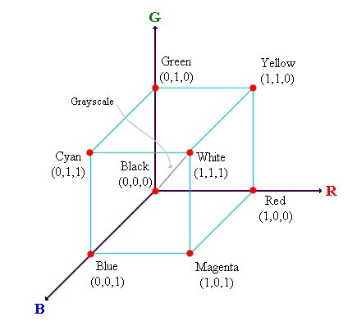
RGB Colour Model

Slide 29
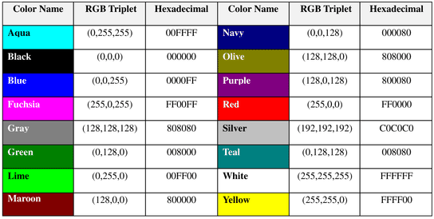
16 Basic Colors

Slide 30
Color Codes
WHITE
BLACK
RED
GREEN
BLUE
MAGENTA
CYAN
YELLOW
AQUAMARINE
BAKER’S CHOCOLATE
VIOLET
BRASS
COPPER
PINK
ORANGE
#FFFFFF
#000000
#FF0000
#00FF00
#0000FF
#FF00FF
#00FFFF
#FFFF00
#70DB93
#5C3317
#9F5F9F
#B5A642
#B87333
#FF6EC7
#FF7F00

Slide 31
Attributes used with <BODY>
MARGINS: set the left hand/right hand and top/ bottom margin of the document
LEFTMARGIN: set the left hand margin of the document
Example:
<BODY LEFTMARGIN="60">
This document is indented 60 pixels from the left hand side of the page.
</BODY>
TOPMARGIN: set the left hand margin of the document
Example:
<BODY TOPMARGIN="60">
This document is indented 60 pixels from the top of the page.
</BODY>

Slide 32
TEXT Color
The TEXT attribute is used to control the color of all the normal text in the document. The default color for text is black. The TEXT attribute would be added as follows:
<BODY BGCOLOR=“#FFFFFF” TEXT=“#FF0000”></BODY>
In this example the document’s page color is white and the text would be red.

Slide 33
LINK, VLINK, and ALINK
These attributes control the colors of the different link states:
1. LINK – initial appearance – default = Blue.
2. VLINK – visited link – default = Purple.
3. ALINK –active link being clicked–default= Yellow.
The Format for setting these attributes is:
<BODY BGCOLOR=“#FFFFFF” TEXT=“#FF0000” LINK=“#0000FF”
VLINK=“#FF00FF”
ALINK=“FFFF00”> </BODY>

Slide 34
Adding a style sheet
<style>………..</style> after <title></title> under<head>
<style>
body {
background-color: #faf2e4;
margin: 0 15%;
font-family: sans-serif;
}

Slide 35
h1 {
text-align: center;
font-family: serif;
font-weight: normal;
text-transform: uppercase;
border-bottom: 1px solid #57b1dc;
margin-top: 30px;
}
h2 {
color: #d1633c;
font-size: 1em;
}
</style>

Slide 36
Using Image Background
The BODY element also gives you ability of setting an image as the document’s background.
An example of a background image’s HTML code is as follows:
<BODY BACKGROUND=“hi.gif” BGCOLOR=“#FFFFFF”></BODY>

Slide 37
Attributes used with <BODY>
BACKGROUND:
It is used to point to an image file (the files with an extension .gif, .jpeg) that will be used as the background of the document.
The image file will be tiled across the document. Example:
<BODY BACKGROUND="filename.gif">
Your document text goes here
</BODY>

Slide 38
Exercise 2
Add an image to the document
<img src="blackgoose.png" alt="Black Goose logo">

Slide 39
Comment
<!-- This is a comment -->
<!-- This is a multiple-line comment
that ends here. -->
will not be displayed in the browser

Slide 40
Tutorial
Reason out the following
I have changed my document, but when I reload the page in my browser, it looks exactly the same.
2. Half of my page disappeared.
3. I put in a graphic using the img element, but all that shows up is a broken image icon

Slide 41
Validating documents
some of the things validators check for:
The inclusion of a DOCTYPE declaration. Without it the validator doesn’t know which version of HTML or XHTML to validate against.
An indication of the character encoding for the document.
The inclusion of required rules and attributes.
Non-standard elements.
Mismatched tags.
Nesting errors.
Typos and other minor errors.

Slide 42
TEXT TAGS
Text tag are dividing into two categories as:
  -Character-level tags and attributes which applies to formatting of individual letters or words.
  -Paragraph level tags and attributes which apply =To formatting of sections of text.

Slide 43
Paragraph level Tags

Slide 44
Headings, <Hx> </Hx>
Inside the BODY element, heading elements H1 through H6 are generally used for major divisions of the document. Headings are permitted to appear in any order, but you will obtain the best results when your documents are displayed in a browser if you follow these guidelines:
H1: should be used as the highest level of heading, H2 as the next highest, and so forth.
You should not skip heading levels: e.g., an H3 should not appear after an H1, unless there is an H2 between them.

Slide 45
Headings, <Hx> </Hx>
<HTML>
<HEAD>
<TITLE> Example Page</TITLE>
</HEAD>
<BODY>
<H1> Heading 1 </H1>
<H2> Heading 2 </H2>
<H3> Heading 3 </H3>
<H4> Heading 4 </H4>
<H5> Heading 5 </H5>
<H6> Heading 6 </H6>
</BODY>
</HTML>
Heading 1
Heading 2
Heading 3
Heading 4
Heading 5
Heading 6

Slide 46
<h1>Type Design</h1>
<h2>Serif Typefaces</h2>
<p>Serif typefaces have small slabs at the ends of letter strokes.
In general, serif fonts can make large amounts of text easier to
read.</p>
<h3>Baskerville</h3>
<h4>Description</h4>
<p>Description of the Baskerville typeface.</p>
<h4>History</h4>
<p>The history of the Baskerville typeface.</p>
<h3>Georgia</h3>
<p>Description and history of the Georgia typeface.</p>
<h2>Sans-serif Typefaces</h2>
<p>Sans-serif typefaces do not have slabs at the ends of strokes.</p>

Slide 47
Paragraphs, <P> </P>
Paragraphs allow you to add text to a document in such a way that it will automatically adjust the end of line to suite the window size of the browser in which it is being displayed. Each line of text will stretch the entire length of the window.

Slide 48
Paragraphs, <P> </P>
<HTML><HEAD>
<TITLE> Example Page</TITLE>
</HEAD>
<BODY></H1> Heading 1 </H1>
<P> Paragraph 1, ….</P>
<H2> Heading 2 </H2>
<P> Paragraph 2, ….</P>
<H3> Heading 3 </H3>
<P> Paragraph 3, ….</P>
<H4> Heading 4 </H4>
<P> Paragraph 4, ….</P>
<H5> Heading 5 </H5>
<P> Paragraph 5, ….</P>
<H6> Heading 6</H6>
<P> Paragraph 6, ….</P>
</BODY></HTML>
Heading 1
Paragraph 1,….
Heading 2
Paragraph 2,….
Heading 3
Paragraph 3,….
Heading 4
Paragraph 4,….
Heading 5
Paragraph 5,….
Heading 6
Paragraph 6,….

Slide 49
Break, <BR>
Line breaks allow you to decide where the text will break on a line or continue to the end of the window.
A <BR> is an empty Element, meaning that it may contain attributes but it does not contain content.
The <BR> element does not have a closing tag.

Slide 50
Break, <BR>
<HTML>
<HEAD>
<TITLE> Example Page</TITLE>
</HEAD>
<BODY>
<H1> Heading 1 </H1>
<P>Paragraph 1, <BR>
Line 2 <BR> Line 3 <BR>….
</P>
</BODY>
</HTML>
Heading 1
Paragraph 1,….
Line 2
Line 3
….

Slide 51
Horizontal Rule, <HR>
The <HR> element causes the browser to display a horizontal line (rule) in your document.
<HR> does not use a closing tag, </HR>
  used as a logical divider between sections of a page or paragraphs of text.
  The hr element adds a logical divider between sections or paragraphs of text without introducing a new heading level.

Slide 52
Horizontal Rule, <HR>
Attribute | Description | Default Value
SIZE | Height of the rule in pixels | 2 pixels
WIDTH | Width of the rule in pixels or percentage of screen width | 100%
NOSHADE | Draw the rule with a flat look instead of a 3D look | Not set (3D look)
ALIGN | Aligns the line (Left, Center, Right) | Center
COLOR | Sets a color for the rule (IE 3.0 or later) | Not set

Slide 53
Heading groups
HTML5
for identifying a stack of headings as a group.
Browsers that support hgroup know to count only the highest-ranked heading in the outline and ignore the rest
<hgroup>
<h1>Creating a Simple Page</h1>
<h2>(HTML Overview)</h2>
</hgroup>

Slide 54
Horizontal Rule, <HR>
<HTML>
<HEAD>
<TITLE> Example Page</TITLE>
</HEAD>
<BODY>
<H1> Heading 1 </H1>
<P>Paragraph 1, <BR>
Line 2 <BR>
<HR>Line 3 <BR>
</P>
</BODY>
</HTML>
Heading 1
Paragraph 1,….
Line 2
___________________________
Line 3

Slide 55
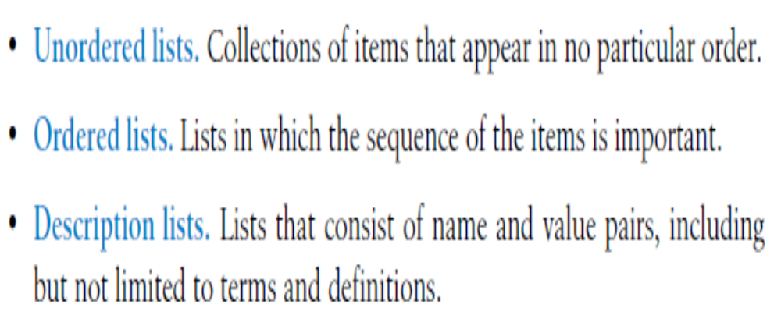
Lists

Slide 56
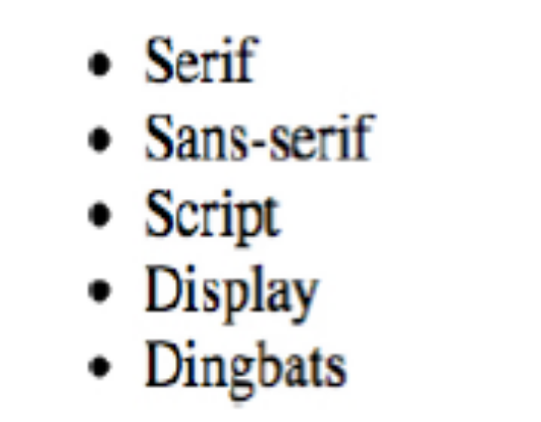
Unordered lists
<ul>
<li><a href="">Serif</a></li>
<li><a href="">Sans-serif</a></li>
<li><a href="">Script</a></li>
<li><a href="">Display</a></li>
<li><a href="">Dingbats</a></li>
</ul>

Slide 57
Exercise 3
Practice:
In the blackgoose bristo example, The salient features are to be displayed in an unorderd list. The features are, hygiene, help desk, 24/7 availability, customer support

Slide 58
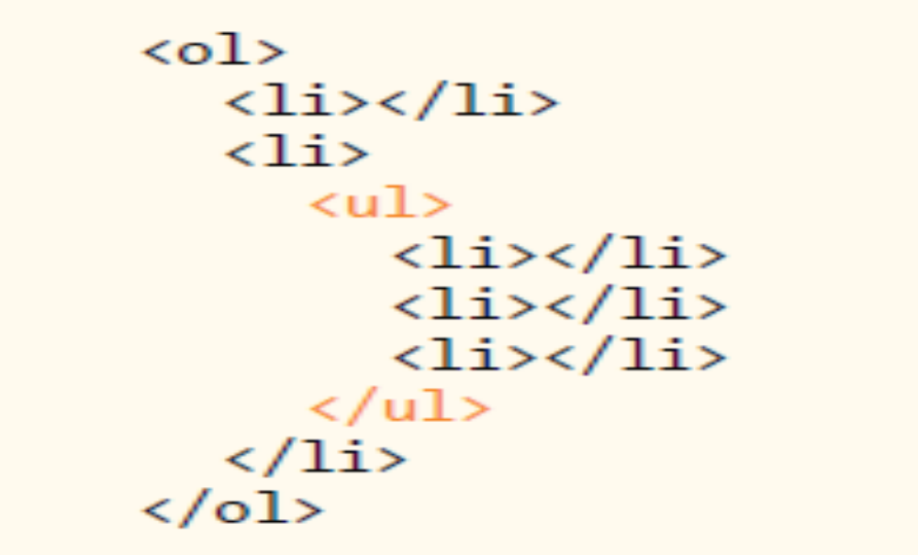
Nesting Lists

Slide 59
Ordered lists
<ol>
<li>Gutenburg develops moveable type (1450s)</li>
<li>Linotype is introduced (1890s)</li>
<li>Photocomposition catches on (1950s)</li>
<li>Type goes digital (1980s)</li>
</ol>

Slide 60
<ol start="17">
<li>Highlight the text with the text tool.</li>
<li>Select the Character tab.</li>
<li>Choose a typeface from the pop-up menu.</li>
</ol>

Slide 61
List Elements
TYPE | Numbering | Styles
1 | Arabic numbers | 1,2,3, ……
a | Lower alpha | a, b, c, ……
A | Upper alpha | A, B, C, ……
i | Lower roman | i, ii, iii, ……
I | Upper roman | I, II, III, ……

Slide 62
What will be the output?
<H1 ALIGN="CENTER">SAFETY TIPS FOR CANOEISTS</H1>
<OL TYPE=“a” START=“2”>
<LI>Be able to swim </LI>
<LI>Wear a life jacket at all times </LI>
<LI>Don't stand up or move around. If canoe tips,
  <UL>
  <LI>Hang on to the canoe </LI>
  <LI>Use the canoe for support and </LI>
  <LI>Swim to shore
  </UL> </LI>
<LI>Don't overexert yourself </LI>
<LI>Use a bow light at night </LI>
</OL>

Slide 63
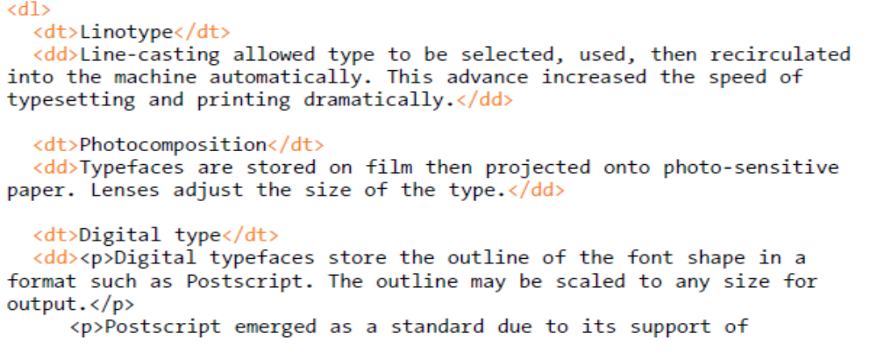
Description lists
Used for any type of name/value pairs, such as terms and their definitions, questions and answers, or other types of terms.
The content of a dl is some number of dt elements indicating the names and dd elements for their respective values (dt-items, dd-definitions of those items)

Slide 64
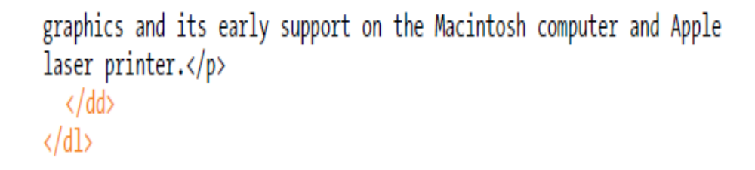
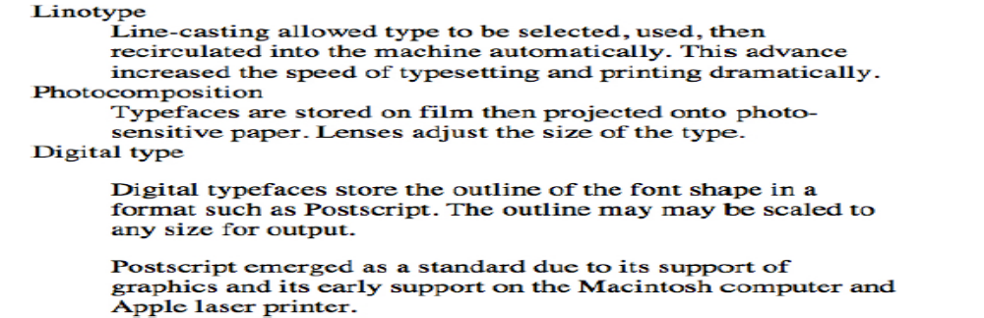
Output

Slide 65
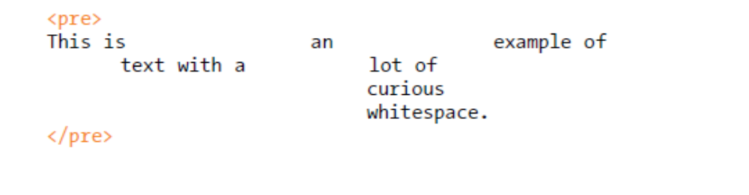
Preformatted Text
Browsers ignore whitespace such as line returns and character spaces in the source document.
The whitespace is important for conveying meaning.
Preformatted text (pre) element.

Slide 66
Figures
Used for content that illustrates or supports some point in the text.
may contain an image, a video, a code snippet, text, or even a table.
<figure>
<img src="piechart.png" alt="chart showing fonts on mobile devices">
</figure>
can add figure caption
<figcaption>
Sample CSS rule.
</figcaption>
  Enclosed within <figure> </figure>

Slide 67
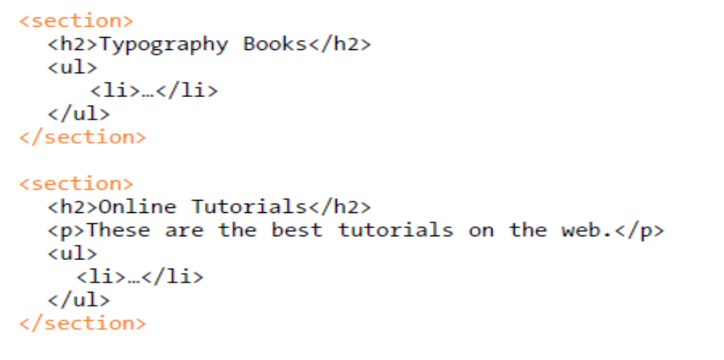
Sections and articles
Section element
  has a broad range of uses, from dividing a whole page into major sections or identifying thematic sections within a single article

Slide 68
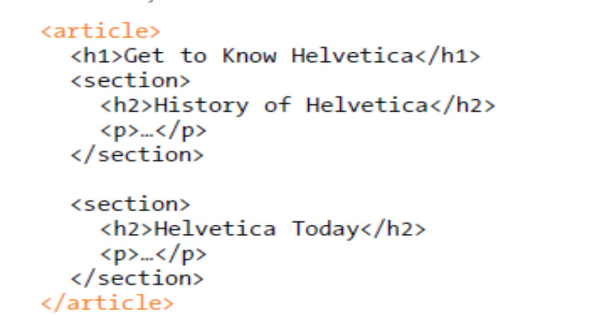
article element for self-contained works that could stand alone or be reused in a different context
  useful for magazine or newspaper articles, blog posts, comments, or other items that could be extracted for external use.

Slide 69
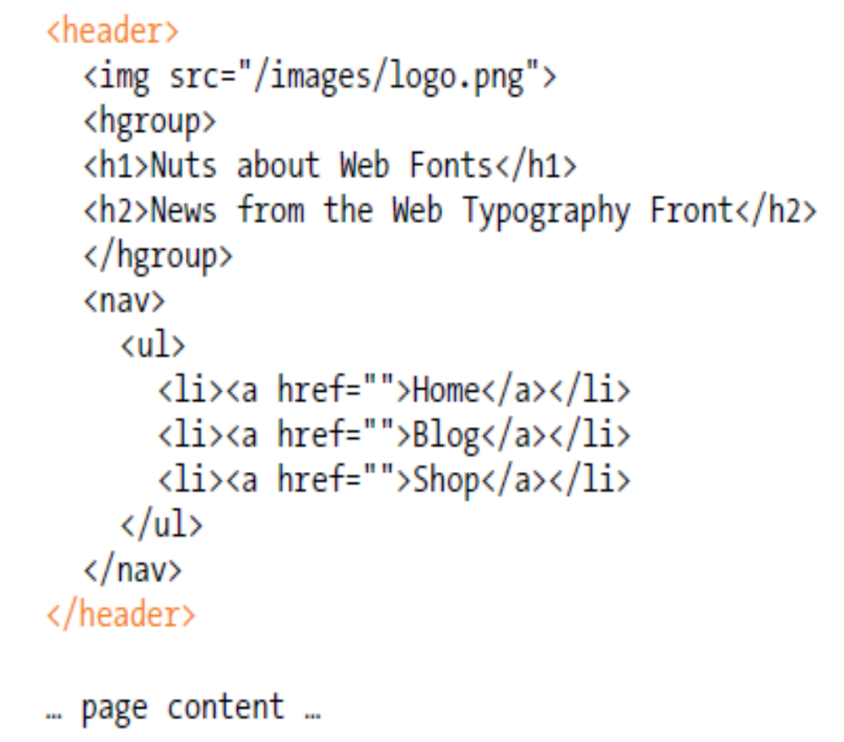
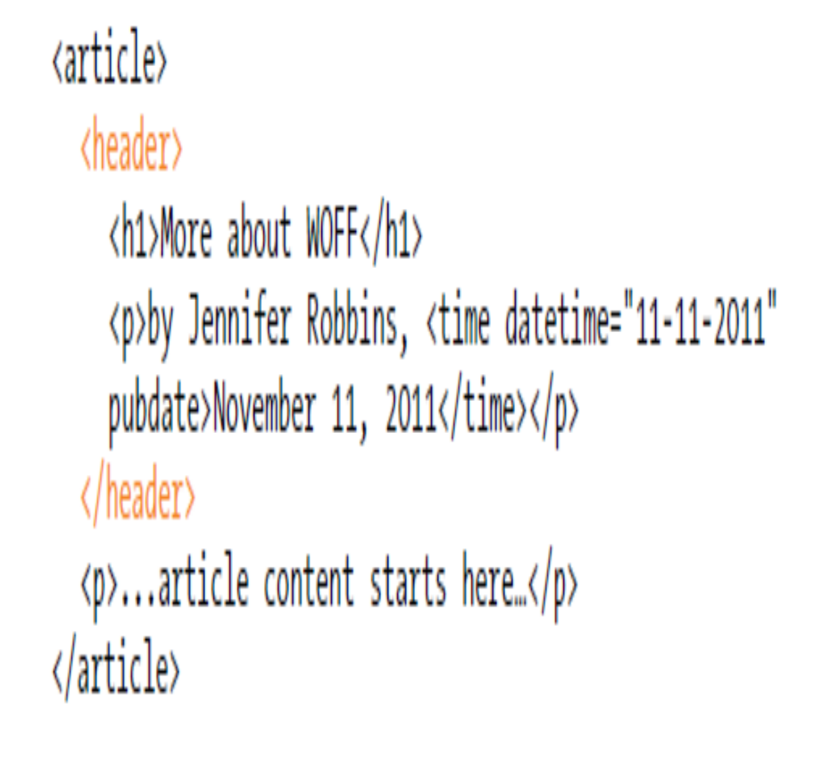
Headers and footers
The header element is used for introductory material that typically appears at the beginning of a web page or at the top of a section or article.

Slide 70
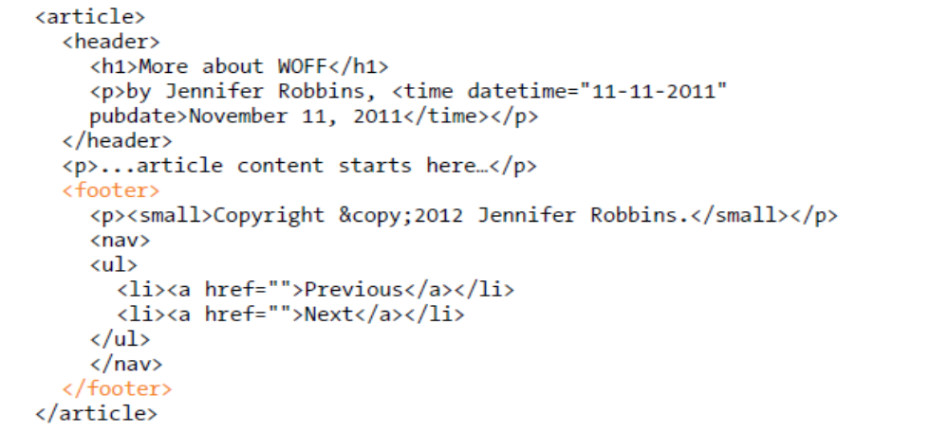
footer
  used to indicate the type of information that typically comes at the end of a page or an article, such as its author, copyright information, related documents, or navigation.

Slide 71
Character Formatting Tag
The character formatting tags are used to specify how a particular text should be displayed on the screen to distinguish certain characters within the document.

Slide 72
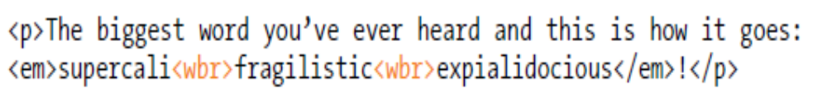
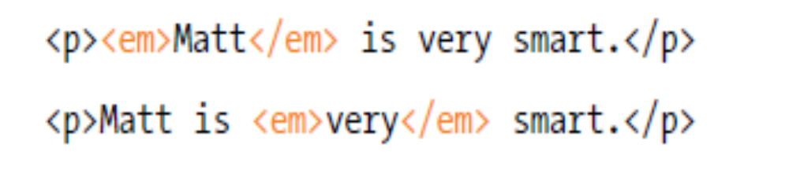
Adding Breaks
Word breaks
Emphasized text
<em>..</em>
  To indicate which part of a sentence should be stressed or emphasized.
mark the place where a word should break if it needs to

Slide 73
Bold, Italic and other Character Formatting Elements
<FONT SIZE=“+2”> Two sizes bigger</FONT>
The size attribute can be set as an absolute value from 1 to 7 or as a relative value using the “+” or “-” sign. Normal text size is 3 (from -2 to +4).
<B> Bold </B>
<I> Italic </I>
<U> Underline </U>
<s>strike through</s>
Color = “#RRGGBB” The COLOR attribute of the FONT element. E.g., <FONT COLOR=“#RRGGBB”>this text has color</FONT>

Slide 74
Font Colors and Size:<FONT
SIZE:
Sets the size of the text, takes value between 1 and
7, default is 3.
Size can also be set relative to default size
for example; SIZE=+X, where X is any integer value and it will add with the default size.
Example:
<FONT SIZE=5> Font Size changes to 5 </FONT>
FACE: Sets the normal font type, provided it is installed on the user’s machine.
Example:
<FONT FACE="ARIAL"> the text will be displayed in Arial</FONT>

Slide 75
Font Colors and Size:<FONT>
By using <FONT> Tag one can specify the colors, size of the text.
Example:
<FONT> Your text goes here </FONT>
Attributes of <FONT> are:
COLOR: Sets the color of the text that will appear on the screen.
It can be set by giving the value as #rr0000 for red (in RGB hexadecimal format), or by name.
Example: <FONT COLOR="RED"> Your text goes here </FONT>

Slide 76
Bold, Italic and other Character Formatting Elements
<P> <FONT SIZE=“+1”> One Size Larger </FONT> - Normal –
<FONT SIZE=“-1”> One Size Smaller </FONT> <BR>
<B> Bold</B> - <I> italics</I> - <U> Underlined </U> -
<FONT COLOR=“#FF0000”> Colored </FONT> <BR>
<EM> Emphasized</EM> - <STRONG> Strong </STRONG> - <TT> Tele Type </TT> <BR>
One Size Larger - Normal – One Size Smaller
Bold - italics - Underlined - Colored
Emphasized - Strong - Tele Type

Slide 77
Bold, Italic and other Character Formatting Elements
.
<STRONG> STRONG </STRONG> Browsers display this as bold.
<TT> TELETYPE </TT> Text is displayed in a mono-spaced font. A typewriter text, e.g. fixed-width font.
<CITE> Citation </CITE> represents a document citation (italics). For titles of books, films, etc. Typically displayed in italics. (A Beginner's Guide to HTML)

Slide 78

Subscript <sub> </sub>: displays text in Subscript
Superscript <sup> </sup>: displays text in Superscript
Small <small> </small>: displays text in smaller font as compared to normal font
Big <BIG>: displays text in larger font as compared to normal font

Slide 79
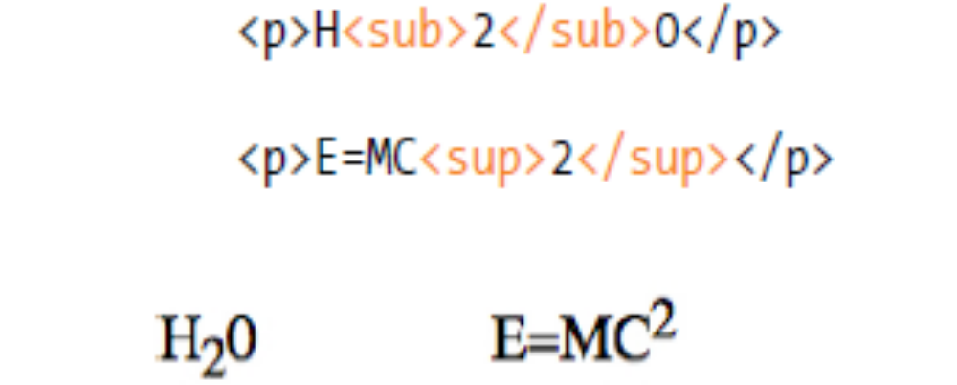
Subscript and superscript
The subscript (sub) and superscript (sup) elements cause the selected text to display in a smaller size, positioned slightly below (sub) or above (sup) the Baseline.

Slide 80
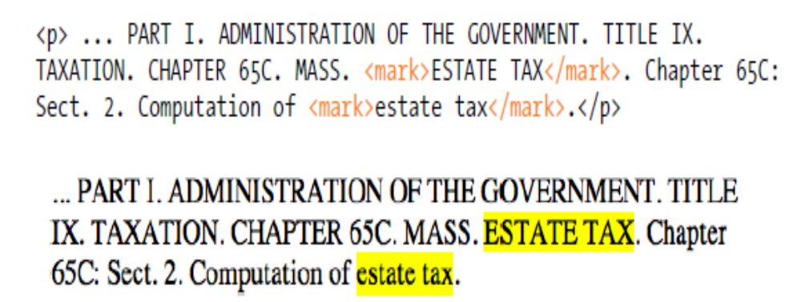
Highlighted Text
mark element indicates a word that may be considered especially relevant to the reader.

Slide 81
Alignment
Some elements have attributes for alignment (ALIGN) e.g. Headings, Paragraphs and Horizontal Rules.
The Three alignment values are : LEFT, RIGHT, CENTER.
<CENTER></CENTER> Will center elements.

Slide 82
Special Characters & Symbols
These Characters are recognized in HTML as they begin with an ampersand and end with with a semi-colon e.g. &value; The value will either be an entity name or a standard ASCII character number. They are called escape sequences.

Slide 83
Special Characters & Symbols
Special Character | Entity Name | Special Character | Entity Name
Ampersand | &amp; & | Greater-than sign | &gt; >
Asterisk | &lowast; ∗∗ | Less-than sign | &lt; <
Cent sign | &cent; ¢ | Non-breaking space | &nbsp;
Copyright | &copy; © | Quotation mark | &quot; "
Fraction one qtr | &frac14; ¼ | Registration mark | &reg; ®
Fraction one half | &frac12; ½ | Trademark sign | &trade; ™

Slide 84
Special Characters & Symbols
Additional escape sequences support accented characters, such as:
&ouml;
  a lowercase o with an umlaut: ö
&ntilde;
  a lowercase n with a tilde: ñ
&Egrave;
  an uppercase E with a grave accent: È
NOTE: Unlike the rest of HTML, the escape sequences are case sensitive. You cannot, for instance, use &LT; instead of &lt;.

Slide 85
An HTML document formatText.html shows the use of
Character Formatting Tags.
<HTML>
<HEAD>
<TITLE>
Use of Character Formatting Text Tags
</TITLE>
</HEAD>
<BODY>
<H1><I> Welcome to the world of Internet</I></H1>
It is a
<FONT COLOR="BLUE" SIZE="4">
<U>Network of Networks</U>
</FONT>
</BODY>
</HTML>
OUTPUT
Welcome to the world of Internet
It is a Network of Networks

Slide 86
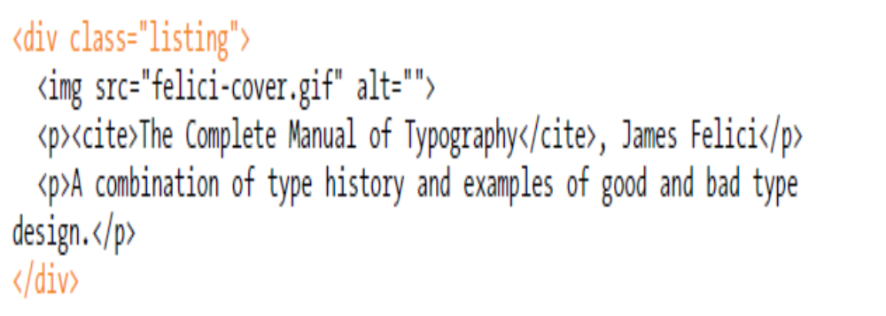
Generic elements
div element is used to create a logical grouping of content or elements on the page.
By marking related content as a div and giving it a unique id identifier or indicating that it is part of a class, you give context to the elements in the grouping.

Slide 87
Span
  it is used for phrase elements and does not introduce line breaks.
<ul TYPE=“square”>
<li>John: <span class="tel">9991.828294</span></li>
<li>Paul: <span class="tel">8886.488976</span></li>
<li>George: <span class="tel">8884.162834</span></li>
<li>Ringo: <span class="tel">9990.322032</span></li>
</ul>
the choice of three bullet types: disc, circle(default), square.
These are controlled in Netscape Navigator by the “TYPE” attribute for the <UL> element
<p>The sea <span style="color:blue">blue</span> in color.</p>

Slide 88
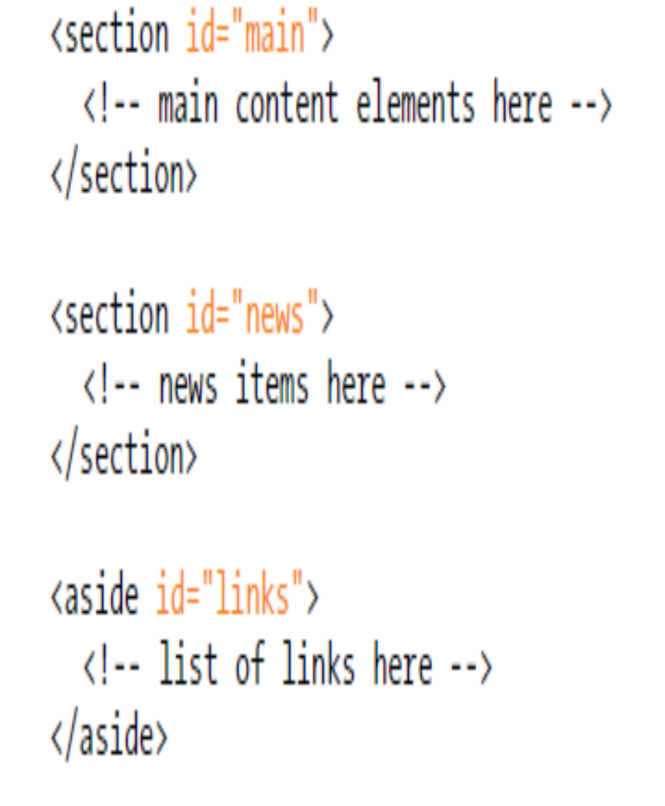
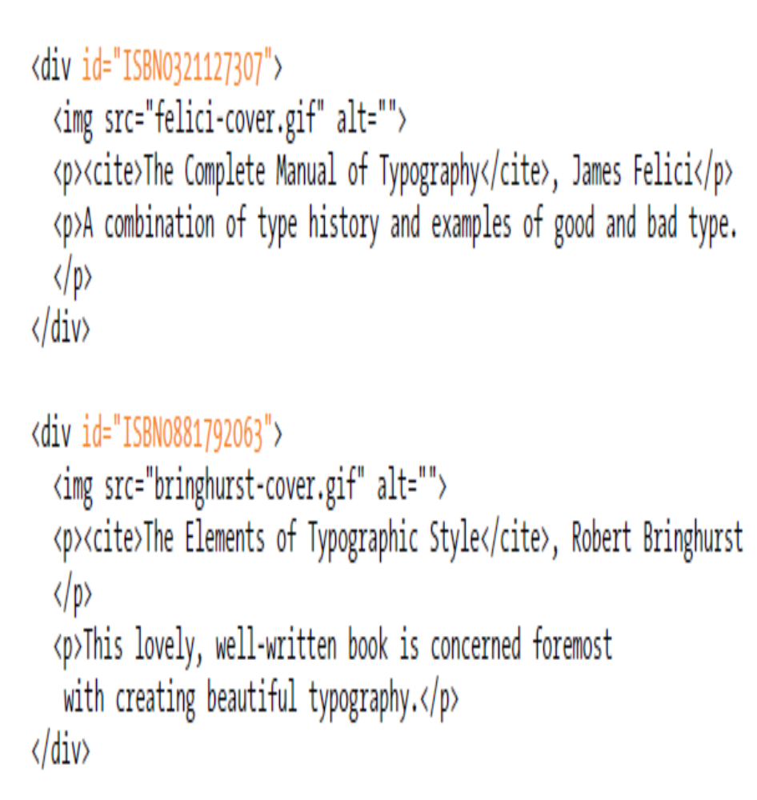
id and class attributes
  id attribute is used to assign a unique identifier to an element in the document.

Slide 89
Working with Tables

Slide 90
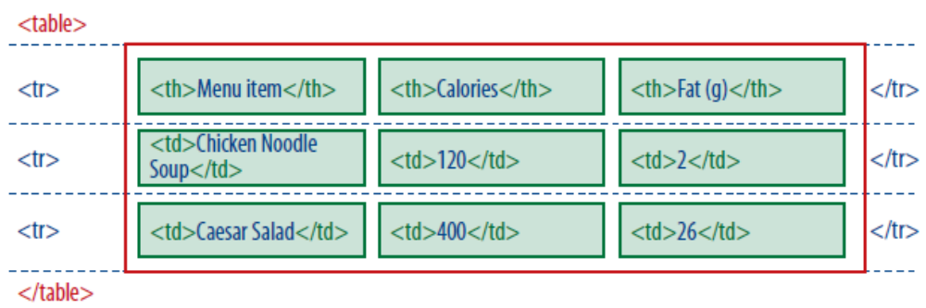
Minimal Table Structure
<table>...</table>
Tabular content (rows and columns)
<tr>...</tr>
Table row
<th>...</th>
Table header
<td>...</td>
Table cell data

Slide 91
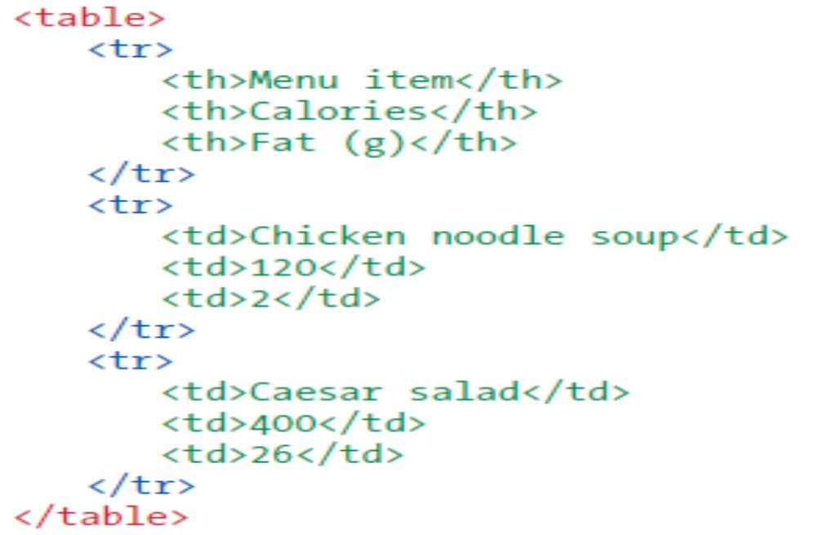

Slide 92
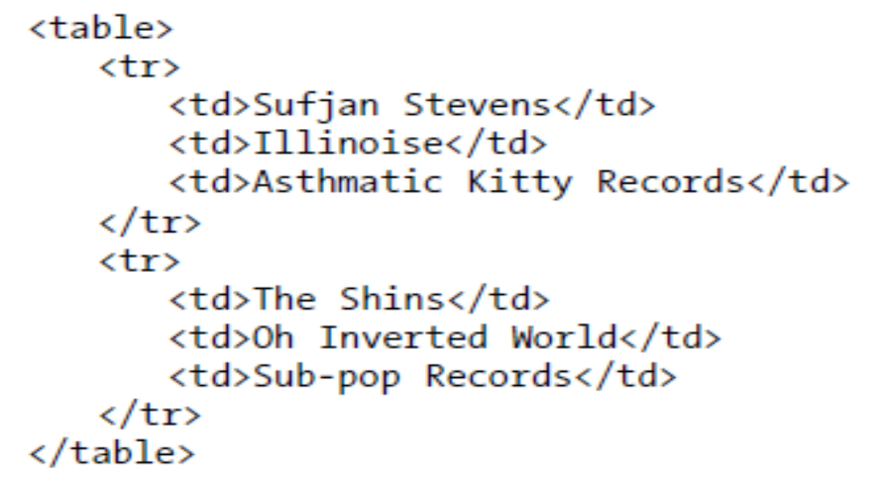
Exercise
Can you point out how may rows and columns the output of the following code produces?

Slide 93
Table Headers
They provide information or context about the cells in the row or column they precede.
The th element may be handled differently than tds by alternative browsing devices.

Slide 94
Spanning Cells
cell spanning, which is the stretching of a cell to cover several rows or columns.
Spanning cells allows you to create complex table structures, but it has the side effect of making the markup a little more difficult to keep track of.

Slide 95
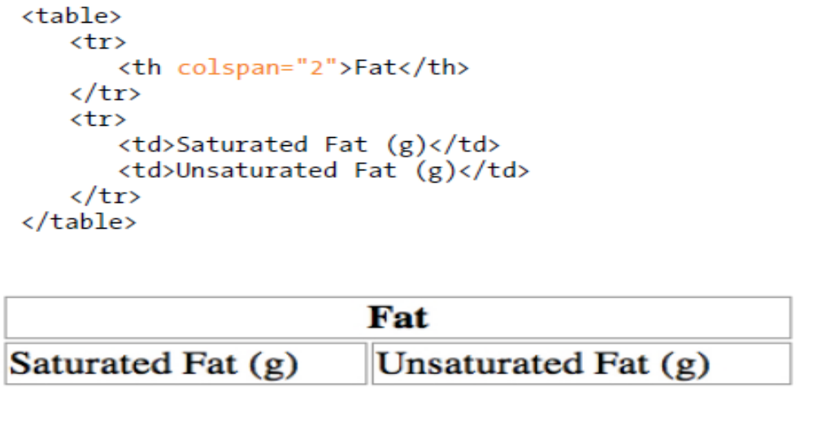
Column spans
created with the colspan attribute in the td or th element,
stretch a cell to the right to span over the subsequent columns
Here a column span is used to make a header apply to two columns

Slide 96
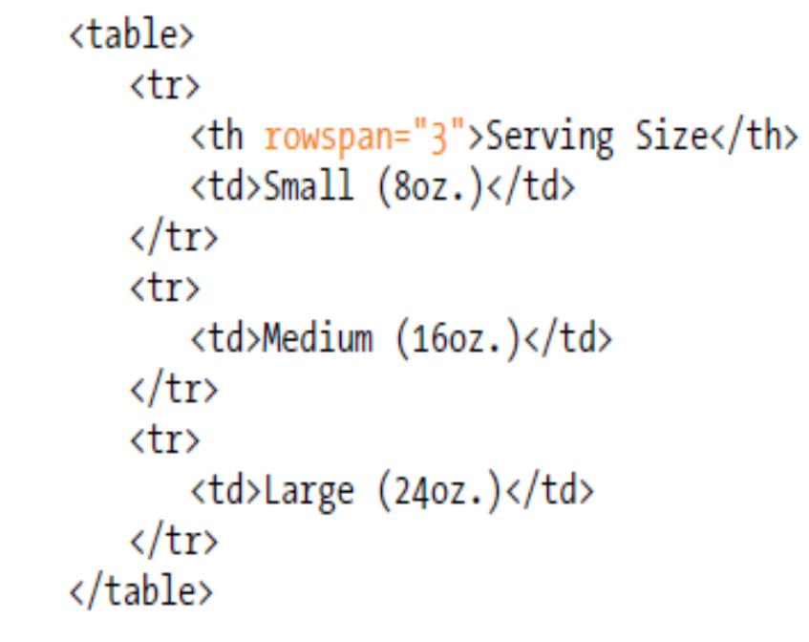
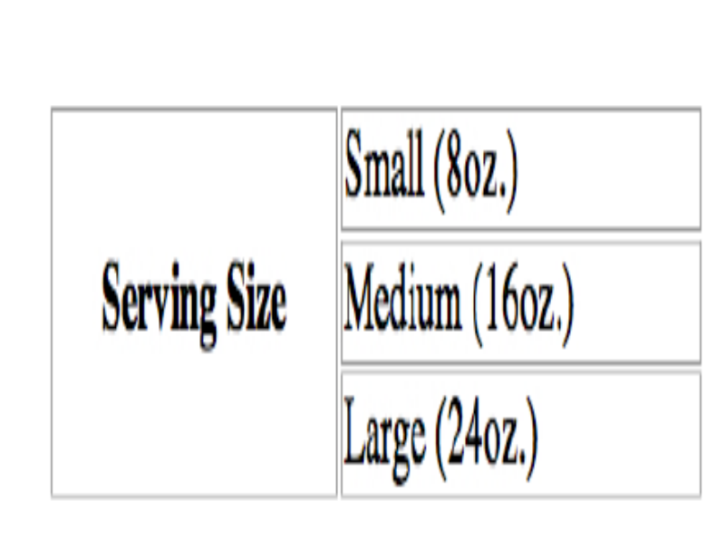
Rowspans
  created with the rowspan attribute.
  but they cause the cell to span downward over several rows.

Slide 97
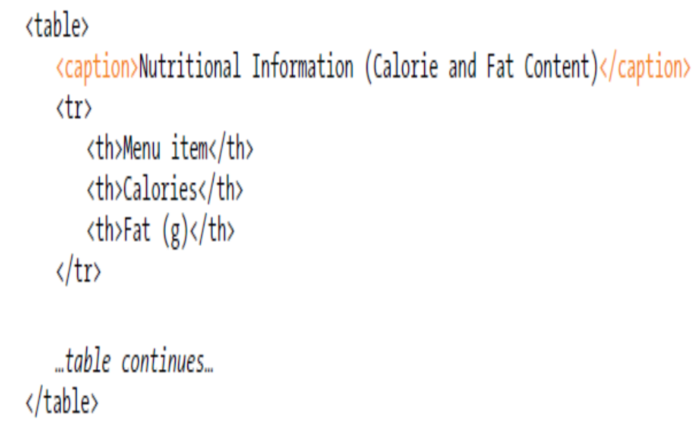
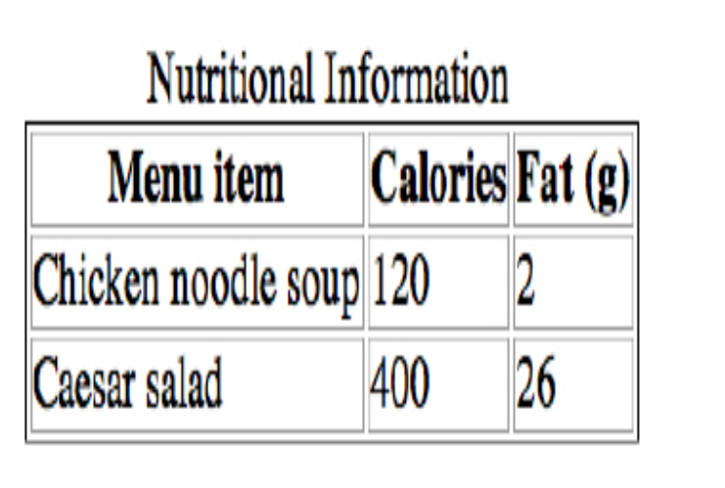
Table Accessibility
Describing table content
caption element to give a table a title or brief description that displays next to the table. You can use it to describe the table’s contents or provide hints on how it is structured.
the caption element must be the first thing within the table element

Slide 98
Adding Images

Slide 99
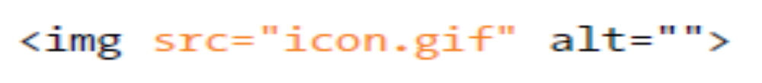
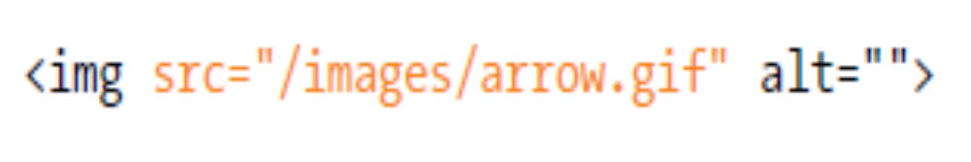
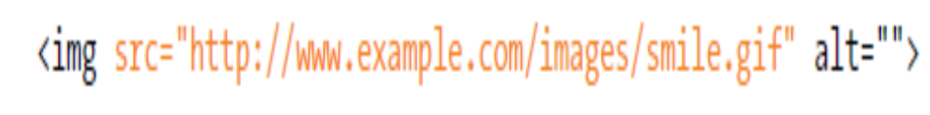
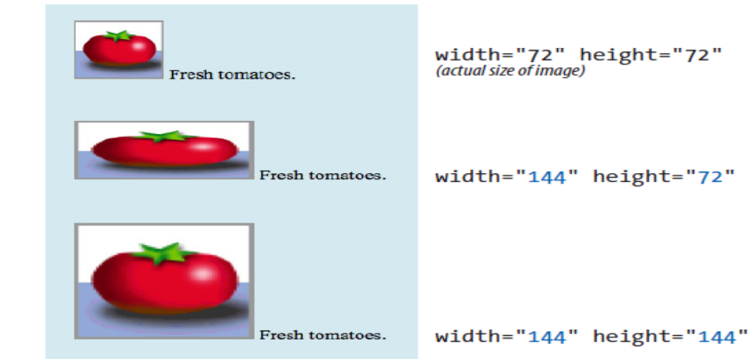

Slide 100
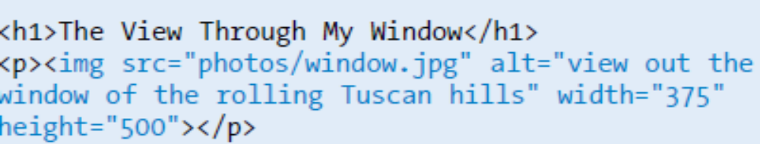

Slide 101
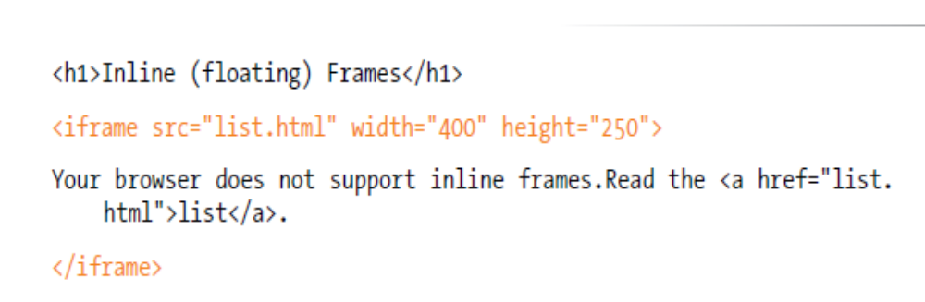
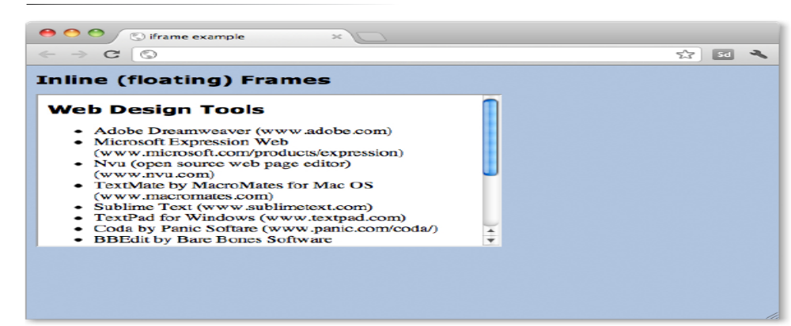
A window in a window

Slide 102
iframe element that lets you to embed a separate HTML document or other resource in a document.

